Slide 1
UVM mini project
Group Y³
Members:
Wong Xiu Yan (Leader)
Wong Yee Chean
Wong Yen Khai

Slide 2
Outline
Introduction
Test Feature and Test Plan
Test Architecture and Sequence Mapping
Monitors Type
Assertion, Code and Functional Coverage
Future Enhancement

Slide 3
01
8-bit data width
02
Serial Peripheral Interface Master Controller
Configurable clock divider (CLK_DIV) for sclk generation
03
A simple state machine with IDLE and TRANSFER states
04
Simple handshaking (start, busy, done) for controller interaction
05
Fixed SPI Mode 1 (CPOL=0, CPHA=1, shift on rising edge, sample on falling edge)

Slide 4
1
Basic Protocol Checks
Handshake Signals and Chip Select
4
Error cases and corner cases
Test
Feature
Sanity and b2b test
2
Data Integrity Checks
TX Data (mosi) and RX Data (miso)
5
UVM-specific checks
Transaction checking and coverage
3
Clock (sclk) Checks
Frequency, IDLE, No Glitches

Slide 5
Test Case
Test Feature | Test Case ID | Description | Methodology
1 | T001 | Ensure start is ignored if busy is high | Scoreboard
1 | T002 | Ensure no new transaction happens until done pulses | Scoreboard
1 | T003 | Ensure busy stays high for exactly 8-bits | Assertion
1 | T004 | Verify done is valid for 1 clock cycle (pulse) after the last bit | Assertion
1 | T005 | Ensure busy deasserts in the next clock cycle after done | Assertion
1 | T006 | Ensure busy goes high in the next clock cycle after start | Assertion
1 | T007 | Ensure cs_n asserts in the next clock cycle after start | Assertion
1 | T008 | Ensure cs_n should not glitch during transfer | Assertion
1 | T009 | Ensure cs_n de-asserts after 8th bits (aligned with done) | Assertion
1 | T010 | Ensure cs_n should not deassert early (eg., after 7 bits) | Assertion
2 | T011 | Ensure SPI works SPI mode of 1. | Scoreboard
2 | T012 | Ensure correct bit order for tx_data which follows MSB-first order | Scoreboard
2 | T013 | Ensure MOSI only changes on rising sclk edges | Assertion (with other clock)

Slide 6
Test Case (Cont.)
Test Feature | Test Case ID | Description | Methodology
2 | T014 | Ensure MISO only sampled in failing sclk edges | Assertion
2 | T015 | Ensure rx_data is matched to the expected slave response (SLAVE_RESET_RESPONSE) | Scoreboard
2 | T016 | Ensure both rx_data and done update at the same clock cycle | Assertion
3 | T017 | Verify sclk frequency matches to the clock divider configuration. | Assertion
3 | T018 | When the SPI is idle, ensure no sclk events and cs_n is pulled high. | Assertion
3 | T019 | Ensure no glitches happen outside transfers | Assertion
4 | T020 | All outputs are set to default/reset values when rst_n = 0 | Assertion
4 | T021 | If reset occurs during transfer, abort ongoing transaction and clear outputs | Scoreboard
4 | T022 | Verify done does from the first transfer does not corrupt the next start | Scoreboard
4 | T023 | Ensure no operation starts until reset deassert. | Assertion
2 | T024 | Ensure data from MOSI matches to the slave_rx_data when done=1 | Scoreboard
4 | T025 | Ensure no glitch on sclk rising edge | Assertion
4 | T026 | Ensure no glitch on sclk falling edge | Assertion

Slide 7
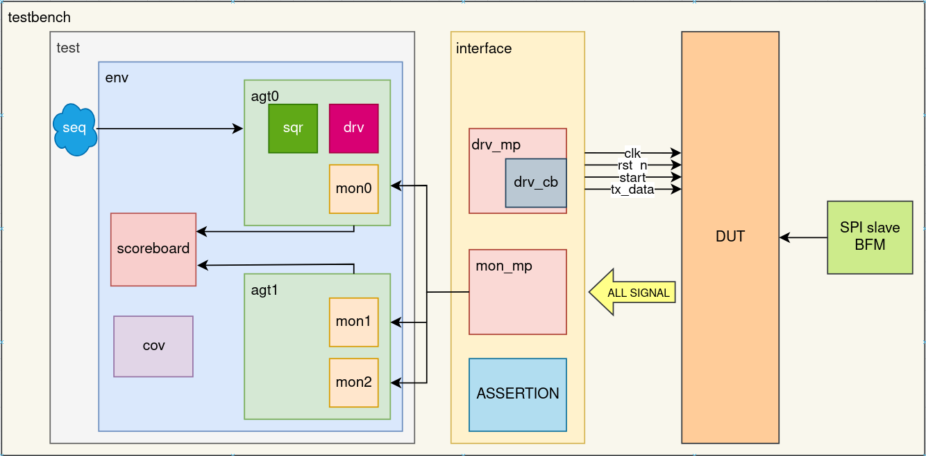
Testbench Architecture
Note: The CLK_DIV is fixed to 4 in this test environment.

Slide 8
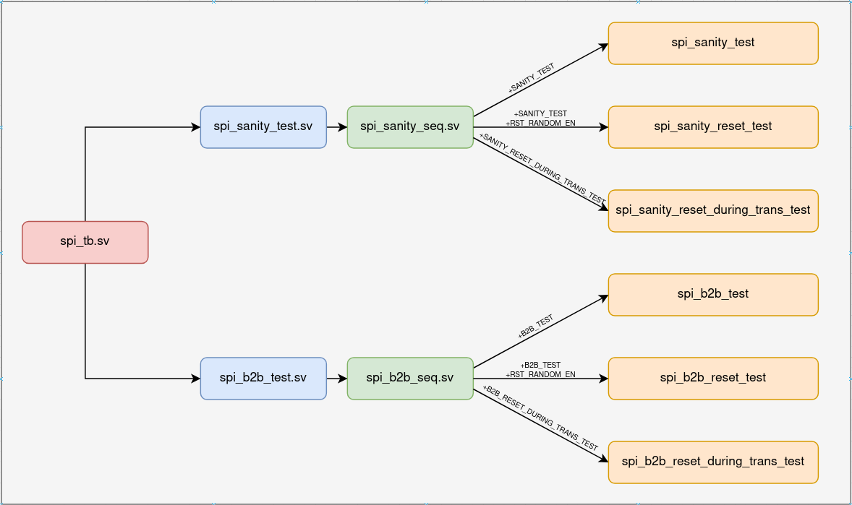
Test Sequence Mapping

Slide 9
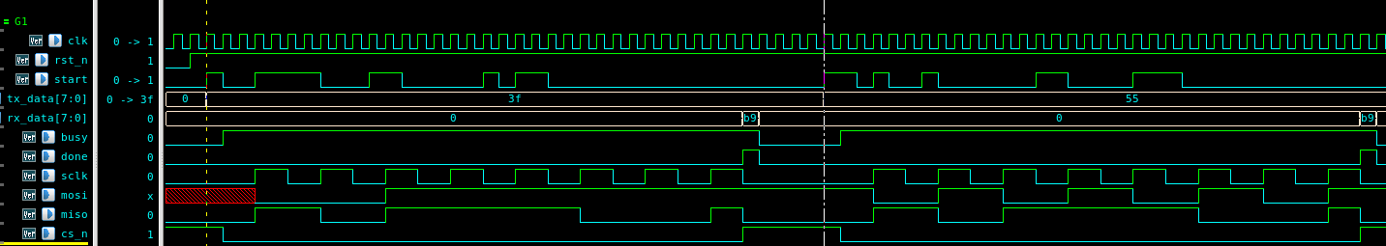
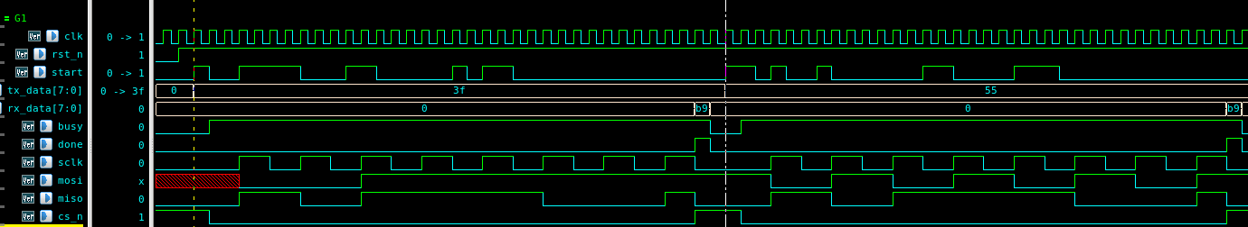
Waveform
1st tran
2nd tran
spi_sanity_test
1st tran
2nd tran
spi_b2b_test
It can be observed that spi_sanity_test introduces a delay between transaction as compared to spi_b2b_test.

Slide 10
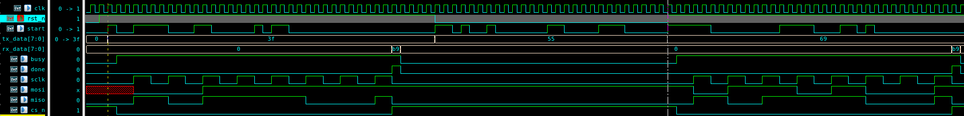
Waveform (Cont.)
1st tran
2nd tran
3rd tran
spi_*_reset_test
As an example, the waveform above illustrates a non-reset transaction, followed by a reset transaction, and then another non-reset transaction.
Note: The only difference between spi_sanity_*_test and spi_b2b_*_test is the presence of a delay between transactions.

Slide 11
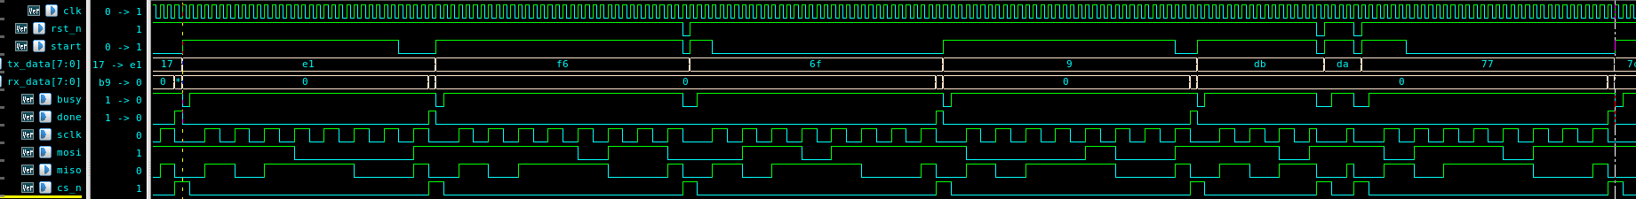
Waveform (Cont.)
(1)
(2)
(3)
(4)
spi_*_reset_during_trans_test
From the waveform above, only 4 transactions are completed, while the rest are interrupted by reset events.
Note: The only difference between spi_sanity_*_test and spi_b2b_*_test is the presence of a delay between transactions.

Slide 12
3 Monitors
0
Start of transaction - ENTIRE
Each mosi bit collection - BIT MOSI
1
End of transaction - ENTIRE
Each miso bit collection - BIT MISO Reset mode value checking - BIT RESET
2
Simulate data collect for different SPI modes.

Slide 13
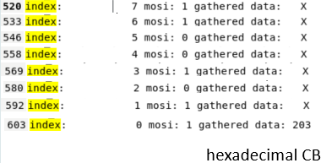
Entire Transaction vs Bit by bit transaction
ENTIRE transaction logging is matching with BIT by BIT logging for tx value as example. Note the transaction starts from MSB.
Entire Transaction
Bit by bit transaction

Slide 14
Monitor 2
Simulate data collect for different SPI modes
use sclk w/o modification and expect for different sampled values when using scheme of mode 0, 2 and 3.
Mode | Leading Edge (MOSI) | Trailing Edge (MISO)
0 | posedge sclk | negedge sclk
1 | posedge start - negedge sclk | posedge sclk
2 | posedge start - posedge sclk | negedge sclk
3 | negedge sclk | posedge sclk
Reference: https://en.wikipedia.org/wiki/Serial_Peripheral_Interface

Slide 15
Monitor 2 Example
CPOL 0 CPHA 0 Leading
scoreboard_log_OL0HA0_L.txt
CPOL 0 CPHA 0 Trailing
scoreboard_log_OL0HA0_T.txt
Mode 0
Each sampling mode generate 2 files
(leading and trailing)
CPOL 0 CPHA 1 Leading
scoreboard_log_OL0HA1_L.txt
Mode 1
CPOL 0 CPHA 1 Trailing
scoreboard_log_OL0HA1_T.txt
Mode 2
CPOL 1 CPHA 0 Leading
scoreboard_log_OL1HA0_L.txt
CPOL 1 CPHA 0 Trailing
scoreboard_log_OL1HA0_T.txt
Mode 3
CPOL 1 CPHA 1 Leading
scoreboard_log_OL1HA1_L.txt
CPOL 1 CPHA 1 Trailing
scoreboard_log_OL1HA1_T.txt

Slide 16
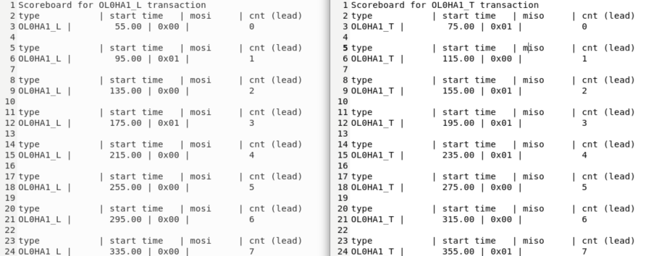
Monitor 2 example
Example log file for mode 1 leading and trailing data sampling:
0b01010000 -> 0x50 0b10111001 -> 0xB9

Slide 17
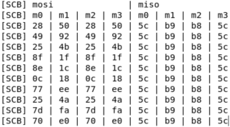
Monitor 2 example
For simulated different mode of sampling, see that on MOSI, mode 0 and mode 2 differs from mode 1; on MISO, mode 3 differs from mode 1.
This conclude that DUT is operating under mode 1, with clock signal as control signal (hence clock is never altered).
Collection of data across all transactions

Slide 18

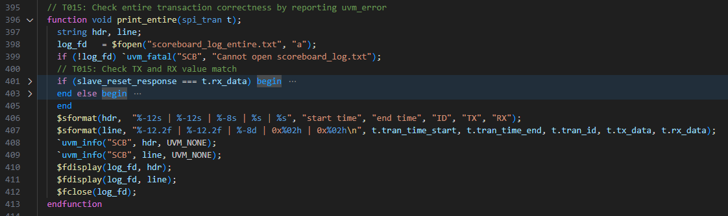
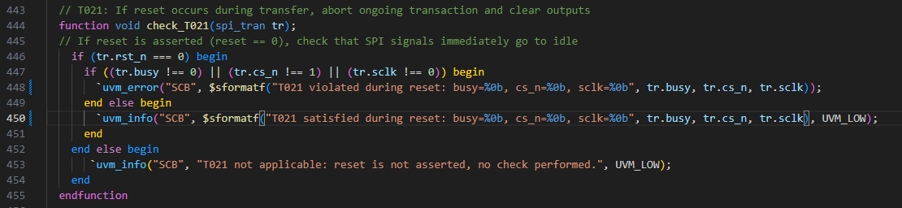
Scoreboard Example

Slide 19
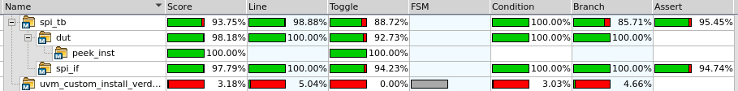
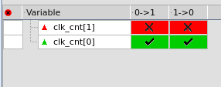
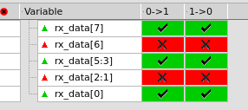
Code Coverage
clk_cnt[1] never toggle due to clk_cnt maxing at CLK_DIV/2 - 1. This does not impact functionality, but may benefit from code optimization or restructuring for clarity.
The SPI slave in the testbench is hardcoded to continuously drive 8’hB9 on MISO. As a result, the SPI master (rx_data) always captures 8’hB9.

Slide 20
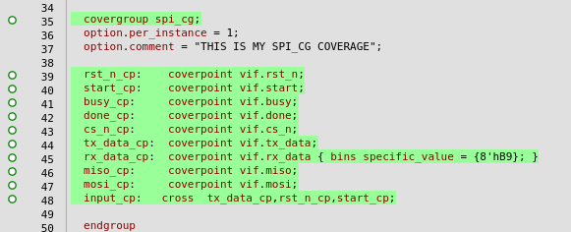
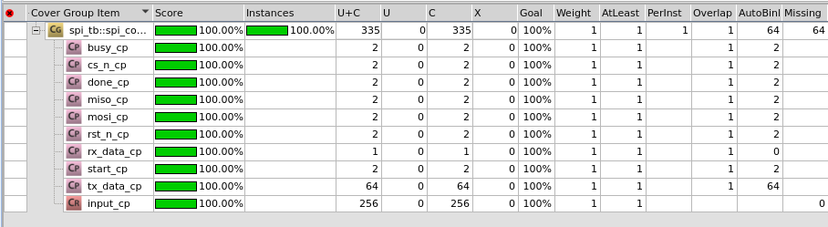
Functional Coverage

Slide 21

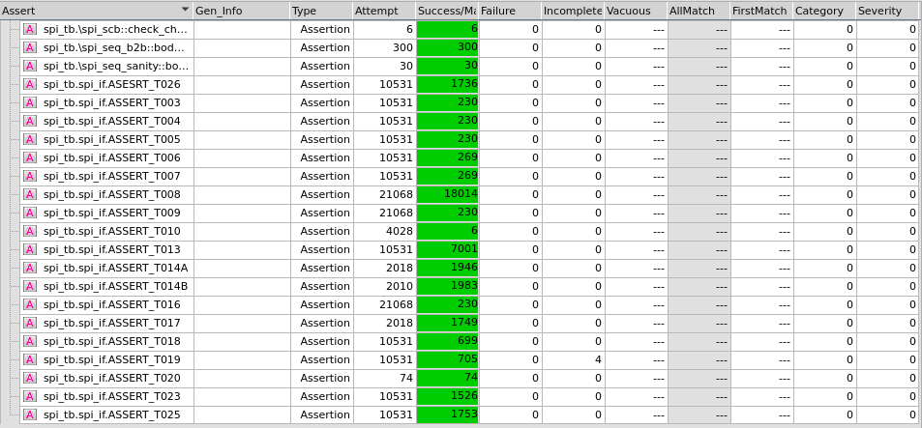
Assertion Report

Slide 22
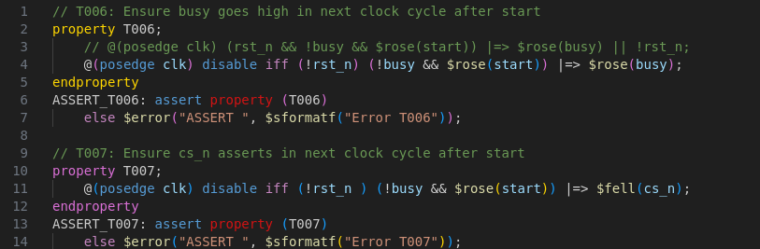
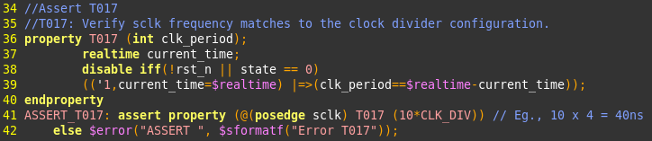
Assertion Example

Slide 23
Future Enhancement
Missing test completion indicator in spi_test.sv
Add logic to track sent vs. processed transactions
Ensure test ends only after full validation
Modular SPI Mode Configuration
Update the testbench to support plug-and-play configuration of different SPI modes, allowing flexible testing without hardcoded changes.
Parameterize CLK_DIV Setting
Replace hardcoded CLK_DIV = 4 with a configurable parameter, allowing dynamic adjustment of SPI clock frequency for different test scenarios.

Slide 24
Future Enhancement (Cont.)
Scoreboard enhancement
Reduce objects initialized, increase reuse rate where non-conflict.
Avoid hardcoding and utilize dynamic naming for scalable solution.
Monitor function cleanup
Monitor 1 and monitor 2 has overlapping functionalities that could be cleaned up with better function control and coordination between monitors.

Slide 25


GitHub
Excel

Slide 26
Thank you

